Slide 1
Title: House Prices in India
Notes:
Slide 1: Welcome Message
Welcome to House prices in India presentation
Mention your name
Mention the title of the assignment

Slide 2
1.0 Introduction
Real Estate business in India is booming due to the increase in population (over 1.3 billions) and urbanization.
An understanding of the house prices is vital for the companies in real estate industry as it helps them make strategic decisions and better position themselves in the market.
Moreover, stable or appreciating house prices tend to attract domestic and international investors' attention, impacting investor sentiment positively for business expansions with a vested interest in desirable property holdings.
Notes:
Slide 2: Introduction
Talk about the need of evaluating the house prices in India e.g. due to the ever growing population and urbanization.
Real estate companies need to know the prices of houses in India to make informed decisions. This can be made possible by developing predictive models.
Evaluation of house prices in India would help investors (both domestic and international) decide whether to venture into the business or not.

Slide 3
Thesis Statement
The purpose of the research is to identify the factors or rather the variables that play crucial role in determining the prices of houses in India.
To achieve this, a predictive model has to be constructed and its accuracy validated.
This will enable the ever growing population of India to figure out the type of houses they want to acquire with their respective price tags.
Notes:
Slide 3: Thesis Statement
The need of this assignment is to come up with a predictive model that analyzes all the input variables to generate house prices.
The model’s accuracy will also be determined.
This will help Indians know the size of houses they need alongside their price tags.

Slide 4
Objectives
To identify the input variables that determine the house prices in India.
To create and develop a house prices prediction model.
To validate the accuracy of the model's prediction.
Notes:
Slide 4: Aims
To point out the input variables to be fed to the model.
To come up with predictive models that would determine the house prices.
To confirm the model’s prediction accuracy.

Slide 5
Scope
The research will cover a sample of house prices in India dataset.
Target feature be identified
Input variables be analyzed.
Predictive models developed.
Model accuracy validated using M.L algorithms.
Notes:
Slide 5: Scope
Data was obtained from Kaggle website
Both the input and target variables were identified
Predictive models such as ridge regression and random forests were developed.
Finally, validation of the models’ accuracy.

Slide 6
2.0 Literature Review
Author/ Year of Publish | Content
The government of India via Pradhan Mantri Awas Yojana (PMAY) in 2015. | The program addresses issues of housing such as affordability. The government developed policies that regulate real estate industry.
The Real Estate Act, 2016 (RERA) . | Offer protection to the interests of homebuyers and also to hold real estate developers accountable. Manages and solve Issues.
Notes:
Slide 6: Literature Review
The Indian government through the ministry of Housing and Urban Affairs initiated programs such as Pradhan Mantri Awas Yojana (PMAY) in 2015 to address the housing issues such as affordability.
The reason for that is due to rapid increase in India’s population.
The Real Estate Act, 2016 (RERA) was established to help protect the interests of homebuyers and also to hold real estate developers accountable.
They solve any emerging house disputes.

Slide 7
2.0 Literature Review
Author/ Year of Publish | Content
Knight Frank India Real Estate Report, 2021 | Regional variations such as amount of jobs, infrastructures etc. affected the house pricing.
Notes:
Slide 7: Literature Review
Based on Knight Frank India Real Estate Report, 2021, regional variations such as amount jobs, infrastructures, demand-supply dynamics, and economic growth significantly affected the house pricing.
House prices in cities such as Delhi and Mumbai were relatively higher compared to house prices in rural areas.

Slide 8
3.0 Methodology
3.1 Data
The data was obtained from Kaggle website.
The dataset is made up of 23 columns and 14620 rows.
The price column is used as the target feature while the other columns as input variables.
The analysis of this dataset enables creation of predictive models that can be used to estimate/forecast the future prices of houses in India
Notes:
Slide 8: Methodology
Highlight the data source i.e. Kaggle dataset website.
What the data entails e.g. it is made up of 14620 rows and 3 columns.
Identify the target column (price column). The remaining 22 columns automatically become the input variables.
Conduct analysis of the dataset to develop predictive models that can estimate the future prices of houses in India.

Slide 9
3.0 Methodology
3.2 Tools/Analytics
The analysis of the house prices in India was conducted on Jupyter notebook using Python language.
Machine learning techniques such as Exploratory Data Analysis (EDA), ridge regression, and random forests were used in this research.
Notes:
Slide 9: Methodology
3.2 Tools
The following are the tools used to conduct the analysis of the houses prices in India:
Python Jupyter Notebook in google colab
Machine learning algorithms such as ridge regression and random forests.

Slide 10
4.0 Data Analysis
Download the dataset
Import the csv file with the dataset to colab, then use pandas library to read, manipulate, and analyze it.
Notes:
Slide 10: Data Analysis
The analysis started by first loading the dataset into the google colab notebook.
Pandas library was used to convert the csv file into readable data frames
The same library was used to clean the data and prepare it for analysis.

Slide 11
Data Exploration
print(House_price_df.head(10))
House_price_df.columns
Some of the observed input variables:
Date, number of bedrooms, area of the house, number of schools nearby, lot area, number of floors, condition of the house, waterfront present, number of views, living area, number of bathrooms etc.
House_price_df.tail(5)
Notes:
Slide 11: Data Exploration
The above line of code was used to generate the first 10 rows of the dataset.
The second line of code was used to output the house features present in the dataset.
The House_price_df.tail(5) code was used to showcase the last 5 rows of the dataset.

Slide 12
Exploratory Data Analysis
Correlation between Input Variables and Target feature (Price)
Input variables such as the number of bathrooms, living area, grade of the house are highly correlated to the price of the house.
Low correlation between the price of house and input variables such as the date, built year, and postal code was observed.
Notes:
Slide 12: EDA
Correlation matrix between the input variables and the target feature (price) was constructed and heat map visualized.
No. of bathrooms, living area, and grade of the house are the input variables highly correlated to the price of the house.
On the other hand, a low correlation coefficient was observed between the price of houses and the input variables such as date, built year, and postal code.

Slide 13
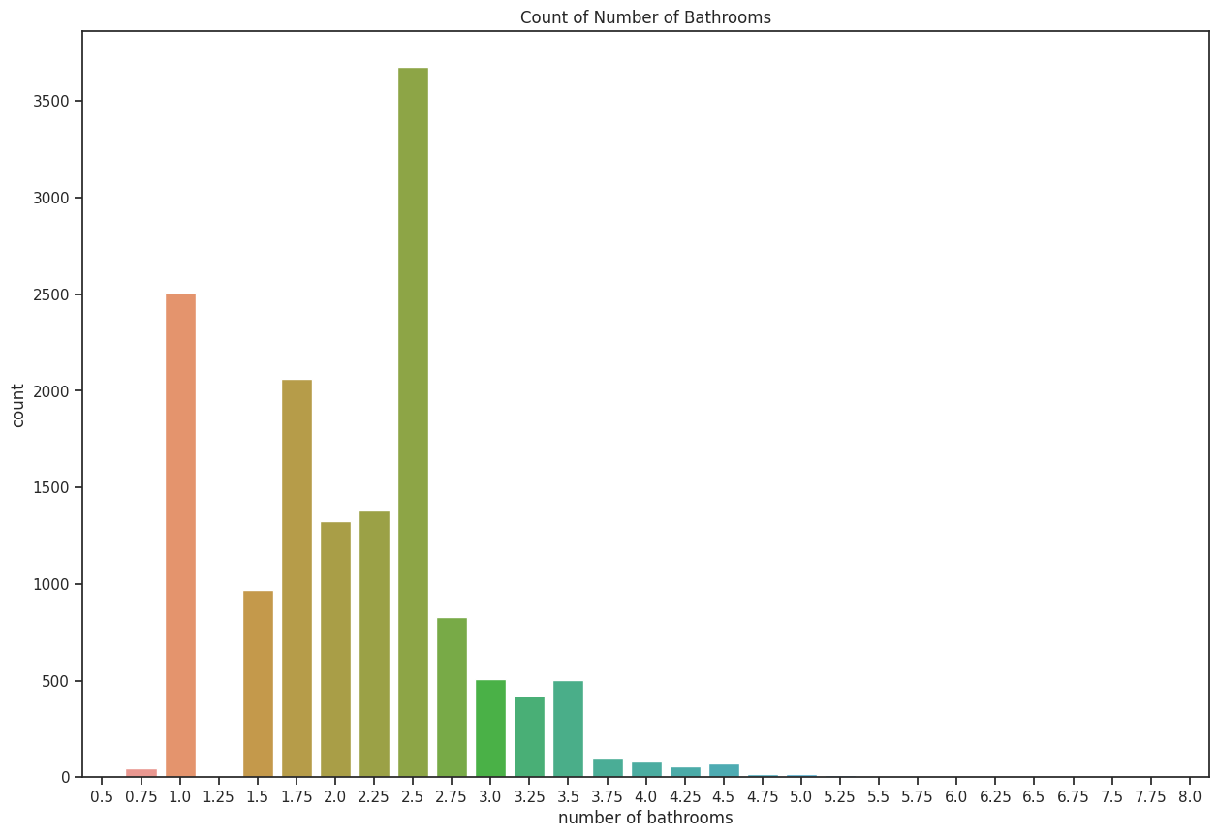
Data Visualization
Notes:
Slide 13: Data Visualization
- A bar plot of the count of number of bathrooms was constructed.

Slide 14
Data Visualization
From the above plot, it is observed that,
Many of the houses have 2.5 bathrooms.
The second in the graph is the houses with only 1 bathroom.
Houses with 0.75, 4.0, 4.25, and 4.5 bathrooms are less in count.
Notes:
Slide 14: Data Visualization
The following inferences were made from the above graph (in slide 13):
Over 3500 houses had 2.5 bathrooms.
About 2500 houses had only 1 bathroom.
Houses with 0.75, 4.0, 4.25, and 4.5 bathrooms were less than 500 in total.

Slide 15
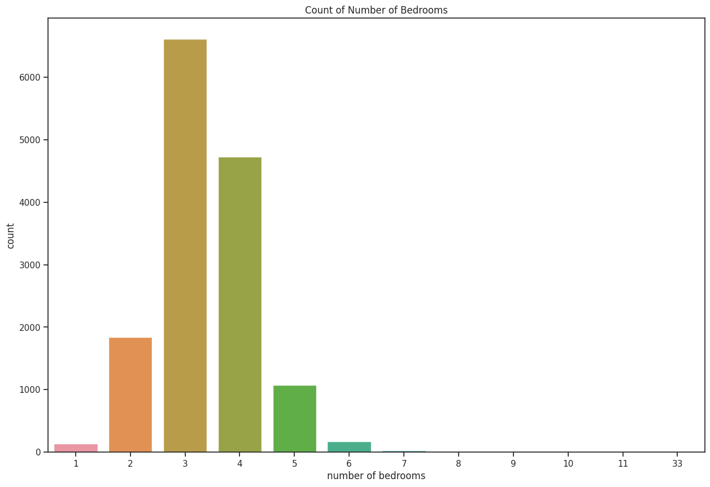
Data Visualization
Notes:
Slide 15: Data Visualization
- This is a count plot of the number of bedrooms.

Slide 16
Data Visualization
From the above countplot, the following inferences can be made:
Most of the houses have three bedrooms. Then followed by four bedroom house.
Houses with only one bedroom were the least in the data.
Notes:
Slide 16: Data Visualization
The following observations can be noted:
Over 6000 houses had 3 bedrooms.
About 4000 houses had 4 bedrooms.
House with 1 bedroom were the least in number i.e. less than 200.

Slide 17
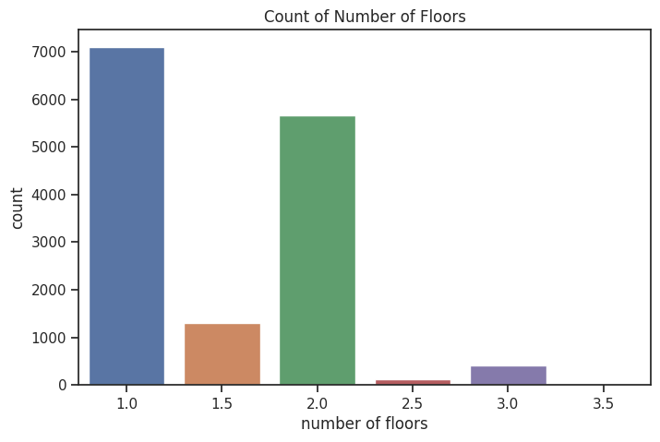
Data Visualization
Notes:
Slide 17: Data Visualization
- The above graph is a count plot of the number of floors.

Slide 18
Data Visualization
The following inferences can be made from the above graph:
Most of the house have only 1 floor.
The second largest count is house with only two floors.
Houses with 2.5 and 3.0 floors are of the least number of counts.
Notes:
Slide 18: Data Visualization
From the above plot, the following can be made:
About 7000 houses had only one floor.
Close to 5500 houses had 2 floors.
Houses with 1.5, 2.5, and 3 were less than 2000 in total.

Slide 19
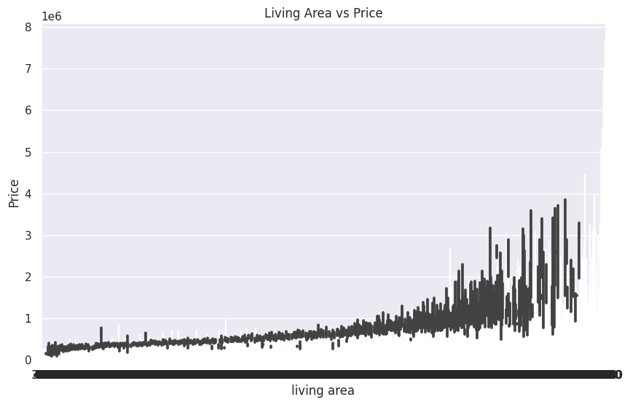
Data Visualization
Notes:
Slide 19: Data Visualization
This is a bar chart of living area against the price of houses.
From the graph, the price of houses increase with increase in the living area.
The house with the largest living area costed 4 million Indian Rupee.

Slide 20
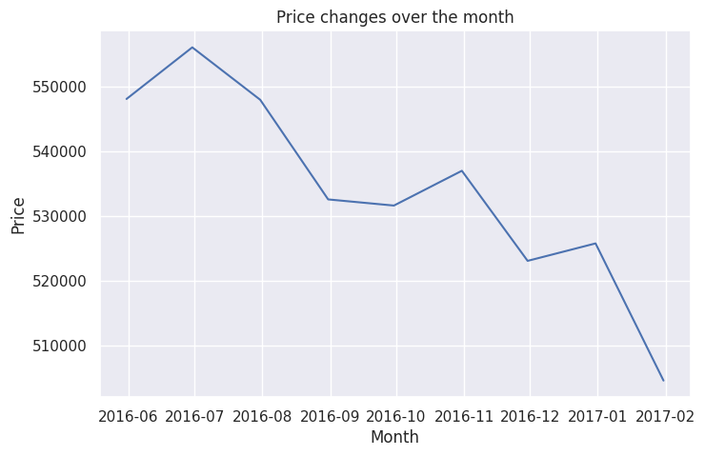
Data Visualization
Notes:
Slide 20: Data Visualization
This is a line chart of price changes over the months.
It can be observed that, the prices of houses significantly drop from July, 2016 to February, 2017 due to marginal dip in land secondary transactions. Read more at: https://economictimes.indiatimes.com/wealth/real-estate/flashback-2016-the-year-gone-by-for-real-estate-sector/articleshow/56774789.cms?utm_source=contentofinterest&utm_medium=text&utm_campaign=cppst

Slide 21
Models
Ridge Regression Technique
print('The RMSE loss for the training set is $ {}.'.format(train_rmse))
The RMSE loss for the training set is $ 192992.43862855725.
print('The RMSE loss for the validation set is $ {}.'.format(val_rmse))
The RMSE loss for the validation set is $ 222351.40444933224.
Notes:
Slide 21: Models
Ridge Regression Technique
Data was split into two sets: Training and validation sets.
The root mean squared error (RMSE) was used as the evaluation metrics.
For training set, the RMSE was $ 192992.43862855725 while the RMSE loss for validation set was $ 222351.40444933224.

Slide 22
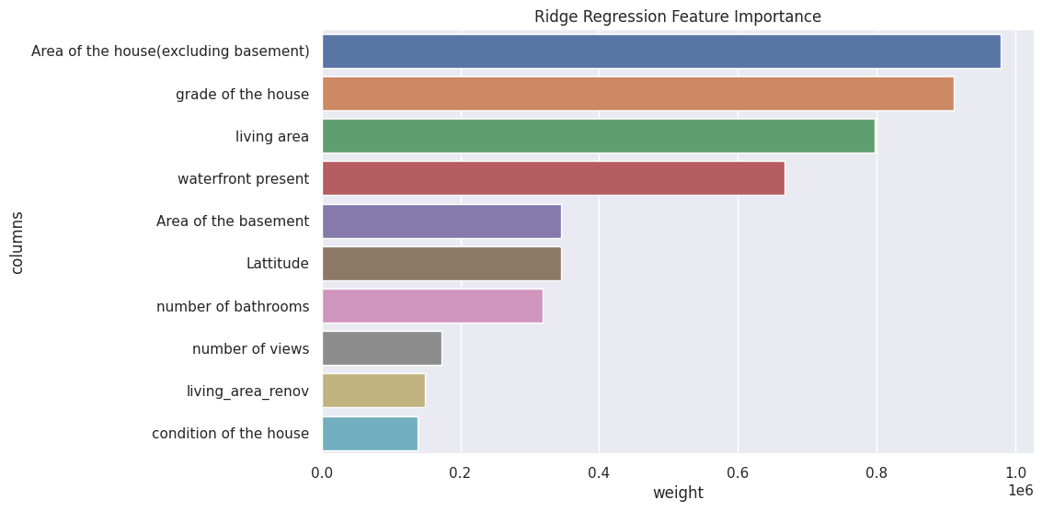
Ridge Regression Feature Importance
Notes:
Slide 22: Ridge Regression Feature Importance
Feature importance technique is used to check the weights and bias of the model.
From the above graph, one would notice that area of the house, grade of the house, and living area were the key features in drafting the house prices.

Slide 23
Random Forests
print('Train RMSE: {}, Validation RMSE: {}'.format(rf1_train_rmse, rf1_val_rmse))
The train root mean squared error is 48062.023716204996 while the validation root mean squared error is 140709.18596951824.
rf1.score(train_inputs, train_targets), rf1.score(val_inputs, val_targets)
(0.9819853180475872, 0.872705659867272)
Notes:
Slide 23: Random Forests
Random forests is another machine learning technique used in determining predictive models.
From this algorithm, RMSE loss for train set was 48062.023716204996 while that of validation set was 140709.18596951824.
Also the model score was evaluated whereby, the train score was 98.2% while the validation score was 87.3%.

Slide 24
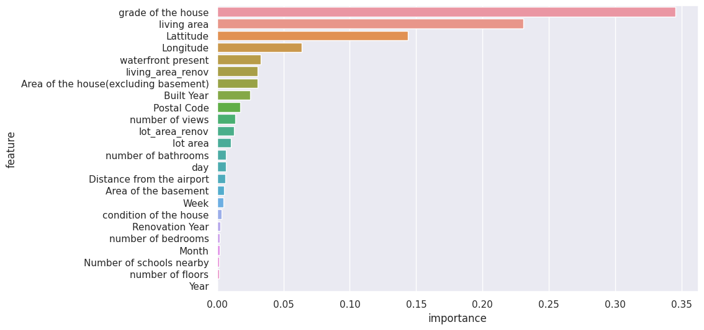
Random Forests Feature Importance
Notes:
Slide 24: Random Forests Feature Importance
- Same as the previous model, features like grade of the house and living area were the most influential features of this model.

Slide 25
Conclusion
The objectives of the analysis were met as the model techniques used (ridge and random forests) predicted the house prices in India.
Random forests method generated better house price predictions than ridge regression.
Input variables such as the grade of the house, living area, area of the house, latitudes, and longitudes play a major role in determining the house prices.
A validation score of 87.27% was obtain from random forests model.
the accuracy score of house prices prediction can be further improved by applying other techniques like XGBoost gradient descent, and hyperparameter tunings
Notes:
Slide 25: Conclusion
Generally touch on the title of the project, the aim of the project.
State the steps followed in acquiring the data e.g. dataset was downloaded from Kaggle website.
Mention the input and target variables.
Highlight the M.L techniques used e.g. Ridge regression and Random Forests.
Mention the validation score obtained.
Offer solutions to how the models can be further improved, e.g. applying other advanced techniques such XGBoost gradient descent, Deep learning techniques such as neural networks etc.

Slide 26
References
Kaggle website: https://www.kaggle.com/search?q=House+price+in+India
Ministry of Housing and Urban Affairs: https://mohua.gov.in/index.php
Osman, A. I. A., Ahmed, A. N., Chow, M. F., Huang, Y. F., & El-Shafie, A. (2021). Extreme gradient boosting (Xgboost) model to predict the groundwater levels in Selangor Malaysia. Ain Shams Engineering Journal, 12(2), 1545-1556.
Notes:
Slide 26: References
- The following were the materials/resources used for the analysis (Mention the above references).

